Slide 1


LogicLens Solutions Pvt. Ltd.
CIN : U72200JH2022PTC019044
Your Virtual Lookout Partner
PITCH DECK

Slide 2
TABLE OF CONTENTS
Who We Are
Problem Statement
Solution
Why Us?
Target Sectors
Market Size
Current and Upcoming Product Portfolio
Road To Product Development
Sales and Revenue Model
System Architecture
Financial Projection
Contact Us

Slide 3
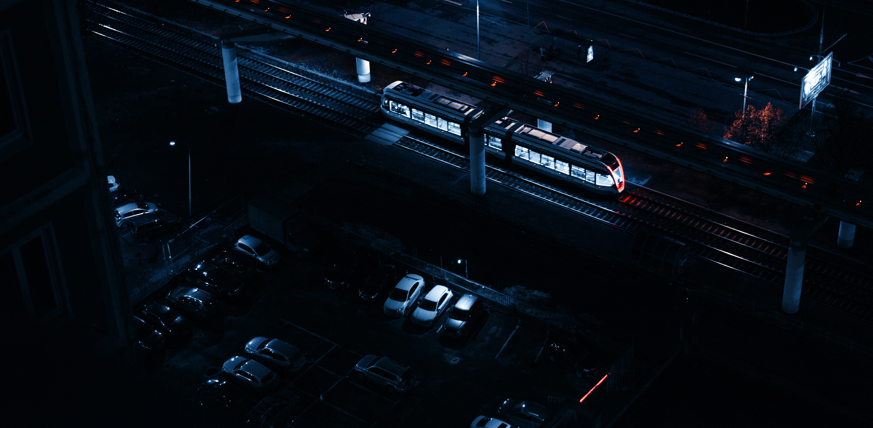
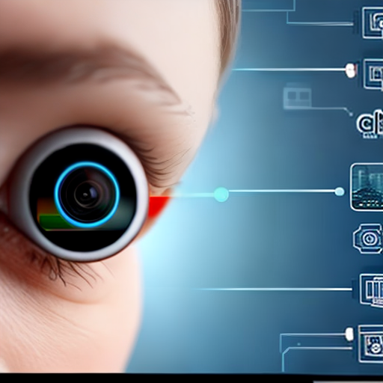
WHO WE ARE
LogicLens is an AI driven Video Analytics firm that can capture events of interest from the cameras in real time or from the recorded feed. It is a proven solution which can provide boon to the clients who considers surveillance as a priority. We have developed, tried and tested use-cases is almost every market sector.

Slide 4
PROBLEM STATEMENT
Manual viewing of CCTV is a mundane task with high possibility of human error.
Impossible to track events which happens in a fraction of second.
Difficult to look back into recorded videos for any missed events which is time consuming.
Critical Inspections become difficult to monitor.
Large areas of surveillance or monitoring large number of cameras simultaneously is difficult with traditional practices .
Human reaction time is much less in cases of hazards.

Slide 5
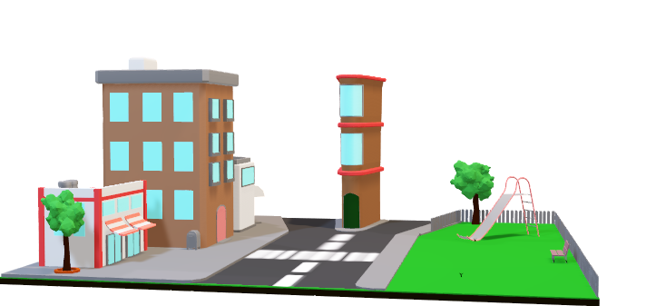

SOLUTIONS
Smart Home Security Solutions
Video Analytics Solution For Workspace
Smart Parking Solution
Urban Space Solution for City, Buildings, Parks
Customized Solutions For Detecting Client Specific Needs
Video Summarization…& Many More

Slide 6
WHY US
SAAS & SUBSCRIPTION BASED
HARDWARE AGNOSTIC
CLOUD+ON-PREMISE
COMPLETE CUSTOMIZATION
SCALABILITY OF THE MODEL
MINIMAL INSTALLATION TIME
In Work sphere create data driven decisions using AI.
Keep Supervision and add Voice Commands to always make your virtual presence being afar.
Link Emergency alerts directly to Hospitals, Fire stations, concerned persons to share appropriate alerts.

Slide 7











TARGET SECTOR
STAGE : 1
STANDALONE BUILDINGS
SCHOOLS AND INSTITUTES
FACTORIES AND INDUSTRIES
SOCIETIES AND COLONIES
EATERIES AND
STORES
RECREATIONAL
AREA
HOSPITALS
AND CLINICS
STAGE : 2
STAGE : 3
SAAS BASED ADVANCED SURVEILLANCE
SMART CITIES, SMART HIGHWAYS, LARGE SURVEILLANCE
STAGE : 4
From Houses to Warehouses Any Client in need of Video Surveillance is our Customer
DRONE BASED ADVANCED SURVEILLANCE
AI BASED SKIN DISEASE / EARLY CANCER DETECTION FOR DERMA

Slide 8
MARKET SIZE
Proof for Need
Market Presence
2021(India)
586K Theft cases
6500 workers died in factory accidents
1.55 Lakh people died in road accidents
5150 Smart City Projects

Slide 9
CURRENT AND UPCOMING PRODUCT PORTFOLIO
OUR CURRENT MVP
An ON-PREM deployable solution which can run on any system/server with standard configuration. The solution can be connected to an IP CCTV camera and can detect events of interest like person count, face recognition, driver distraction and gesture detection.
It captures the above events at or above 10 FPS with accuracy above 80%. Here are some video evidences of our working solution:
https://drive.google.com/drive/folders/1cSegucmHPbBz6G_p65jHI6MfyBW1HKCW
DAKSH-Lens
Al based live video detection
Live Alerts
ViDHI-Lens
Advanced forensic analysis
analysis of recorded footage
Saar-Lens
NEETI-Lens
Video Summarization
Custom Behaviour detection
Advanced tailor made detection

Slide 10
ROAD TO PRODUCT DEVELOPMENT
Vision
On Prem customizable solution with fixed use-cases.
SAAS based solution which will be user-friendly and as &quot;Pay-as-you-use&quot; model. No additional hardware needed apart from IP camera.
Clients can integrate our Core Model using our LogicLens API for 3rdparty app.
On Prem customizable solution with additional use-cases.
Stage:4
Stage:3
Stage:2
Stage:1

Slide 11
SALES & REVENUE MODEL
Subscription Model
Basic Subscription: basic analytics features and support
Pricing
Number of cameras being monitored
Billing Cycle
Monthly
License Model
Free Trials
premium subscription advanced analytics, customized reporting, and dedicated support.
The amount of data being processed
The level of customer support required.
Quarterly
Yearly at a discounted rate
Based of each licenses sold per camera
Basic and Advanced licenses based of requirement deployed at client server.

Slide 12
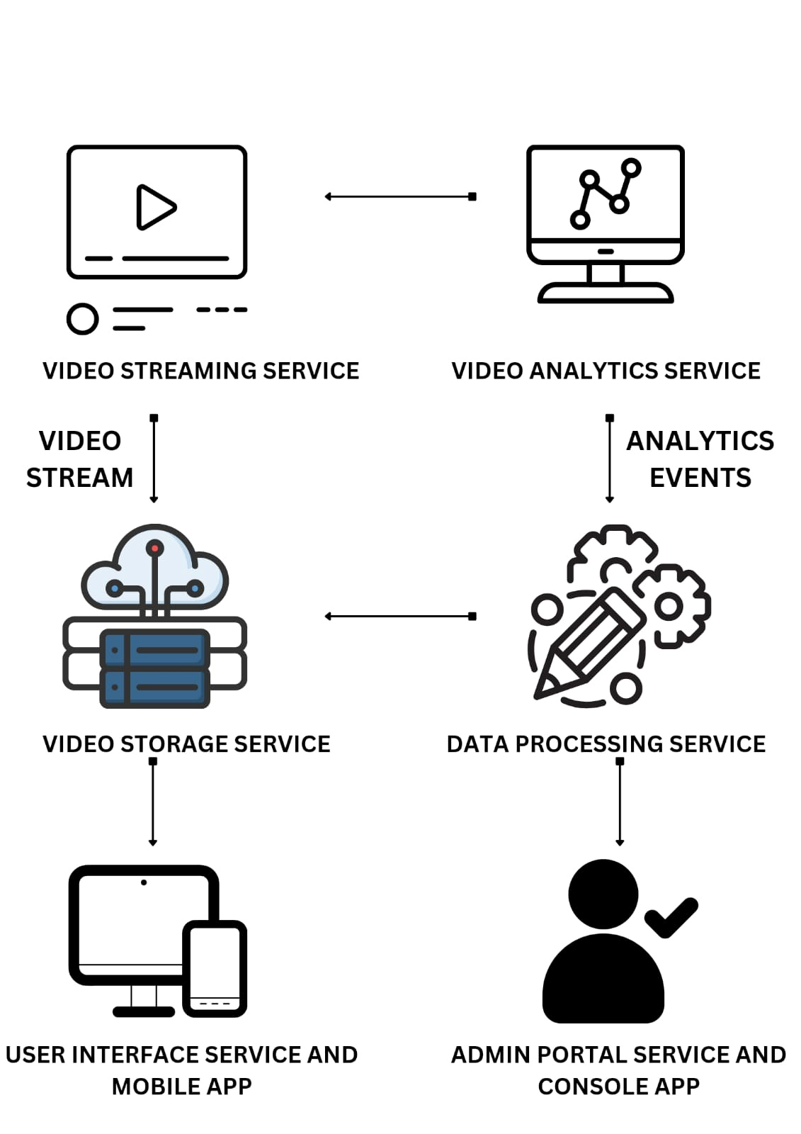
SYSTEM ARCHITECTURE
In this architecture, the solution is composed of several services, including a Video Streaming Service, a Video Analytics Service, a Video Storage Service, a Data Processing Service, a User Interface Service, and an Admin Portal Service.
The video streaming service handles the live streaming of video data from cameras to the system. The video analytics service analyzes the video data in real-time to detect events of interest, such as people or objects moving through a specific area.
The video storage service is responsible for storing the raw video data, while the data processing service processes this data to extract insights and create reports.
The user interface service provides a web-based interface for end-users to view and interact with the system, while the admin portal service provides an interface for administrators to manage the system's settings and users.
Finally, there are mobile apps for end-users and administrators to access the system on-the-go.

Slide 13




FINANCIAL PROJECTION
Our Ask:₹2 Crores
Average Revenue per User/Year:₹2.7 Lakhs
Pre Seed Valuation:₹14.32 Crores
Financial Projections_Valuation_LogicLens.xlsx

Slide 14
CONTACT US
Team Highlights :
Ajay Kumar Satpathy - Product and Marketing
Anushri Pandey - Branding
Anubhav Pandey - Developer
Email : info@logiclens.co.in
LinkedIn : https://www.linkedin.com/company/logiclens/
Phone No : +91 - 7708964718
Visit Us At : www.logiclens.co.in

Slide 15
REFERENCES
https://www.indiatoday.in/auto/latest-auto-news/story/people-killed-in-road-accidents-in-india-in-2021-no-helmet-seatbelt-drunk-driving-overspeeding-2315029-2022-12-29 (MARKET SIZE)
https://www.fortunebusinessinsights.com/industry-reports/video-analytics-market-101114 (MARKET SIZE)
https://drive.google.com/drive/folders/1cSegucmHPbBz6G_p65jHI6MfyBW1HKCW (DRIVE LINK TO EXAMPLES OF WORKING SOLUTION AND VALUATION SHEET)

